Slide 1

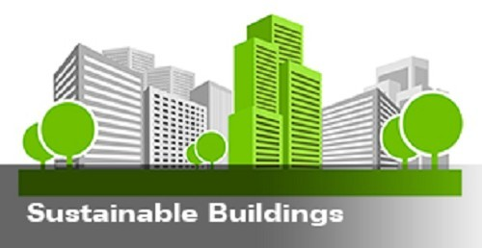
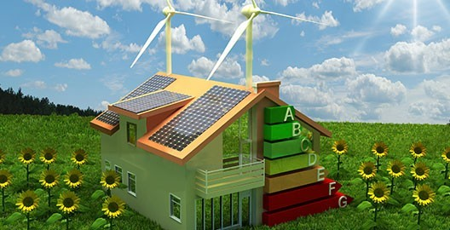

Slide 2
Sustainable Buildings
Building construted with ecofriendly products and,renewable resources and less energy consumption products are termed as sustainable buildings

Slide 3

Sustainable Buildings
Sustainable building is constructed with sustainable materials. Sustainable materials don't stress the environment during their production, use or disposal. Sustainability, whether in materials, energy or practices, means a limited negative impact on natural resources and people; they avoid depleting or degrading the environment.
sustainable materials are renewable resources

Slide 4
Then what is green building ?
Green building is the practice of creating structures and using processes that are environmentally responsible and resource-efficient throughout a building's life-cycle from siting to design, construction, operation, maintenance, renovation and deconstruction.

Slide 5
All sustainable buildings are green buildings but not all green buildings are sustainable

Slide 6

Sustainable materials
Rubber
BAMBOO
CLAY
TIMBER
NEWSPAPER

Slide 7
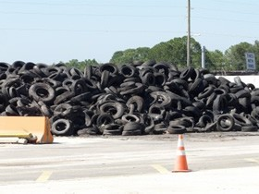
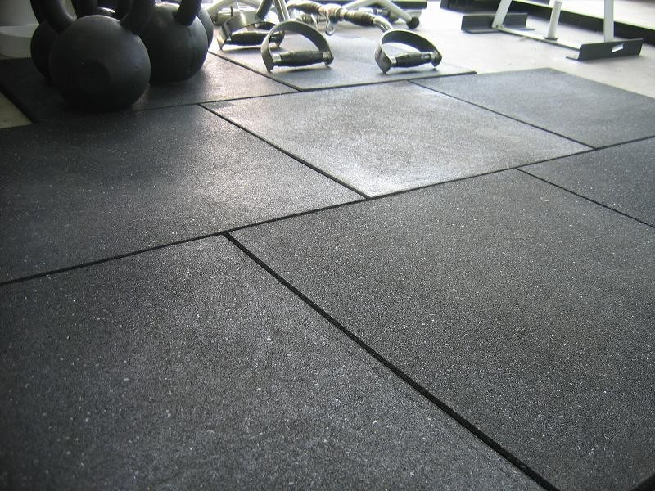
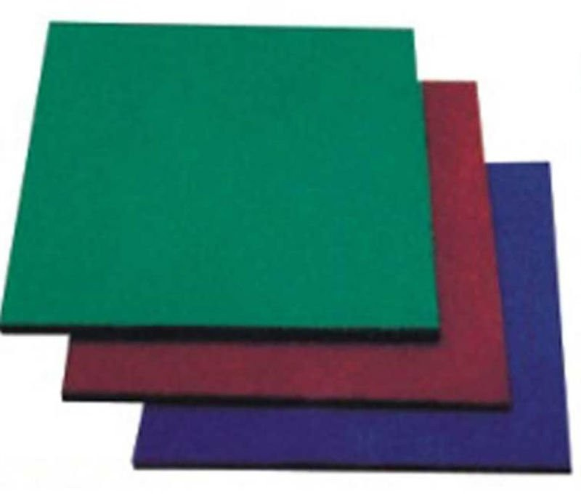
RUBBER
●
Rubber can be recycled and used as flooring

Slide 8

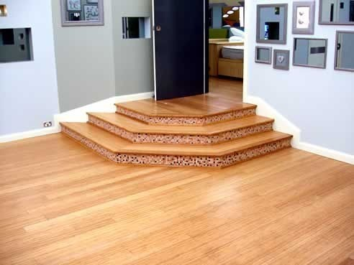
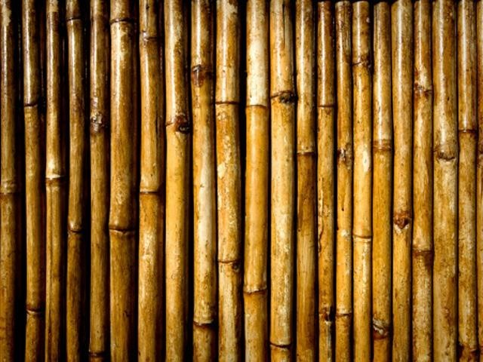
BAMBOO
Sustainable bamboo flooring is a great option for improving the building or construction plans for any project
Bamboo is a great anti-bacterial and it is also water resistant

Slide 9

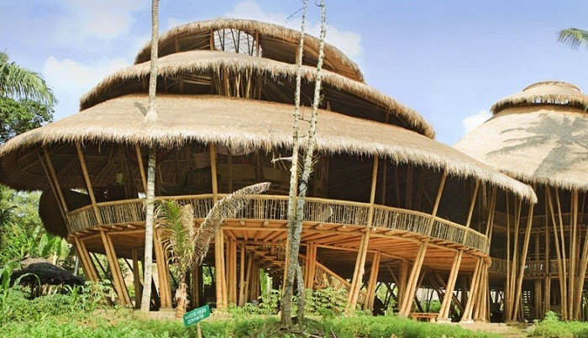
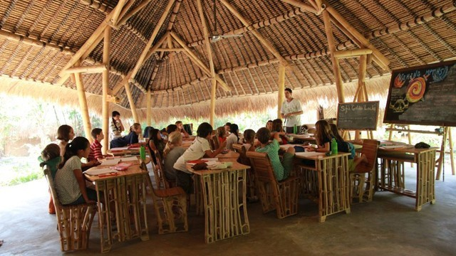
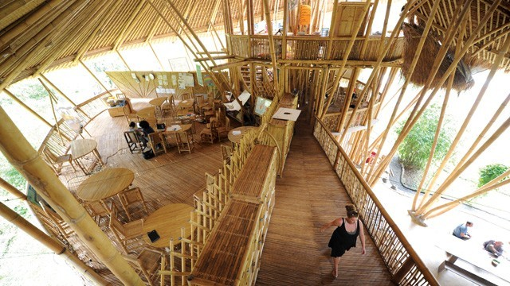

Slide 10
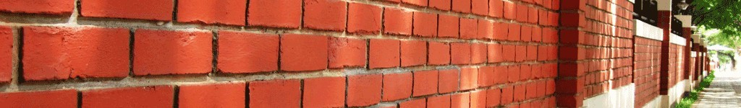
Clay
●
The clay is usually added to straw(rice straw), sand, and then water in order to make bricks that are used as walls.

Slide 11

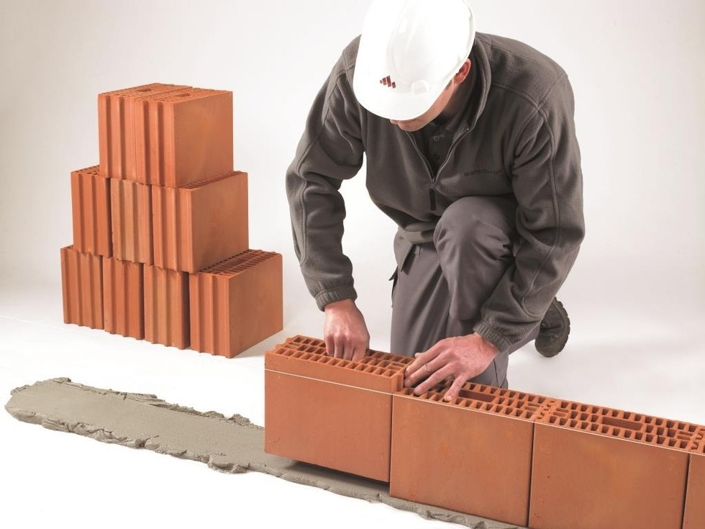
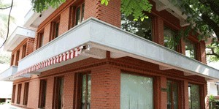
Walls made of clay blocks

Slide 12
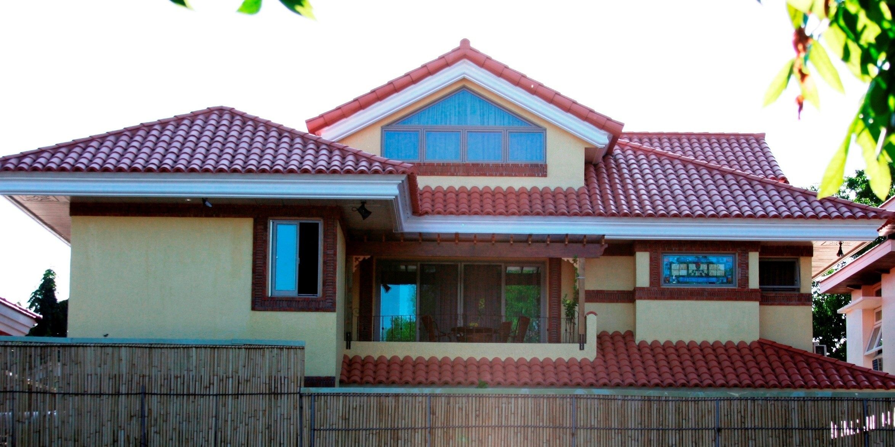
Roofing made of clay

Slide 13

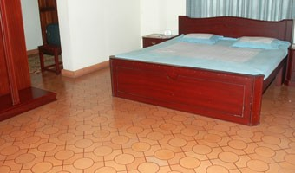
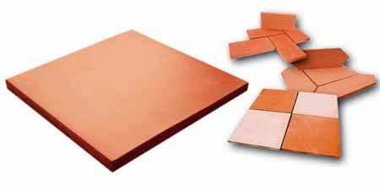
Tiles made of clay

Slide 14

TIMBER
Wood prepared for use in building. Recycling timber is the environmentally friendly product
Timber recycling or wood recycling is the process of turning waste timber into usable products. ...
Recycling timber is the environmentally friendliest form of timber production and is very common in countries such as Australia and New Zealand where supplies of old wooden structures are plentiful.

Slide 15

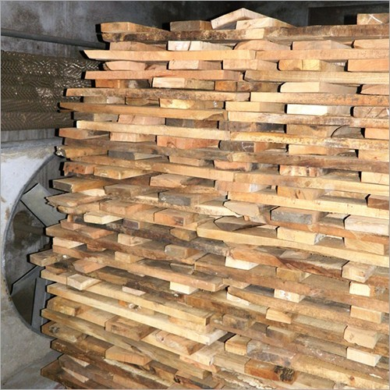
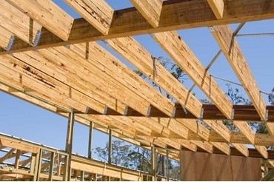
N. OW LET US SEE HOW TIMBER CAN BE USED IN OUR CONTRUCTION PROJECTS.
FRAMES
RUNNERS

Slide 16

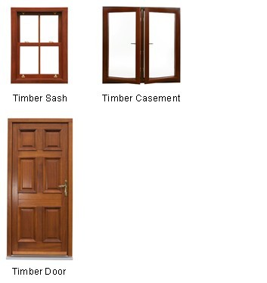
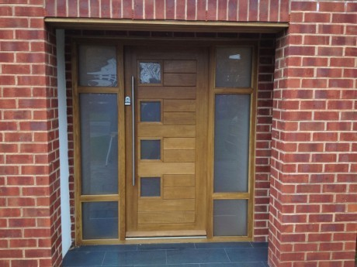
Timber Front Door and Garage Door
`

Slide 17
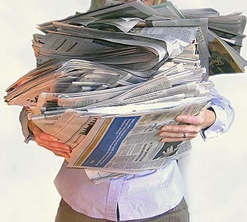
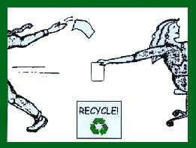
PAPER
●
Paper is a renweable resource

Slide 18
One of the Renewable product of paper is Warmcell insulation
Warmcel installed into walls reduces solar overheating dramatically and helps in keeping temperature stable with reduced fluctuations between days and nights.

Slide 19
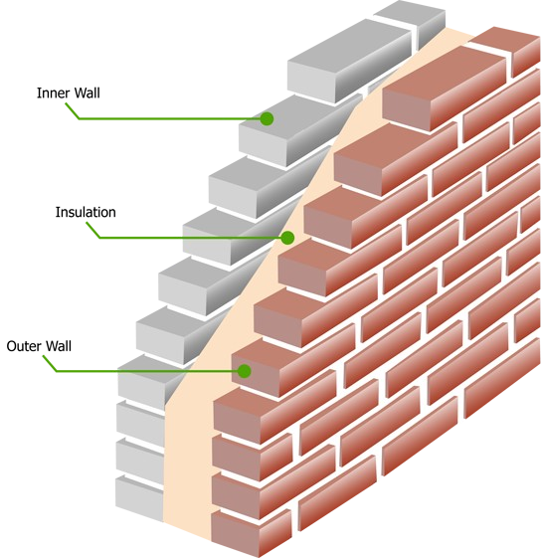
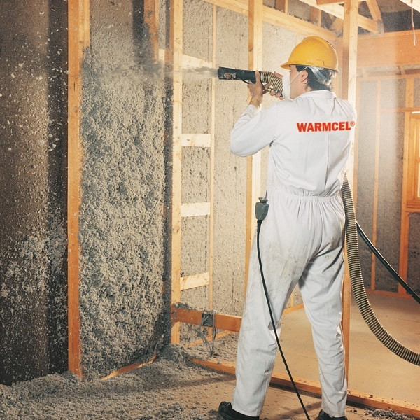
WARMCELL FOR PARTITION WALLS
WARMCELL AS A INSULATION FOR WALLS

Slide 20
Technology Available
Centre for ASTRA (Application of Science and Technology for Rural Areas) was formed in 1974 at Indian Institute of Science (IISc), Bangalore to cater to developing technologies for sustainable development.
Recently, this centre has been renamed as ‘Centre for Sustainable Technologies’.

Slide 21
Search kr k ae nxt clas m

